Slide 1
Introduction: Flaring in the oil and gas Industry
Gas flaring: is the burning of natural gas associated with oil extraction.
The process of crude oil extraction produces a byproduct of a mixture of Hydrocarbon gases, most notably , Methane (CH4).
Since oil production mostly happen in stranded locations, the norm in the industry has been burning the gas, hence the name flaring.
Over a 100-year period, Methane has a Global Warming Potential (GWP) that is 34x that of CO2. Making this issue a major climate concern.

Slide 2


Slide 3
Problem
1- Around 140 billion cubic meters of natural gas is flared globally each year.
City Consumption
In 2020, New York uses around 60 TWh of electricity per year.
813 TWh could power a city of New York's magnitude for over 16 year
Data Centers:
In 2020, data centers worldwide consumed an estimated 200 TWh.
813 TWh could power the world's data centers for a little over 4 years

Slide 4
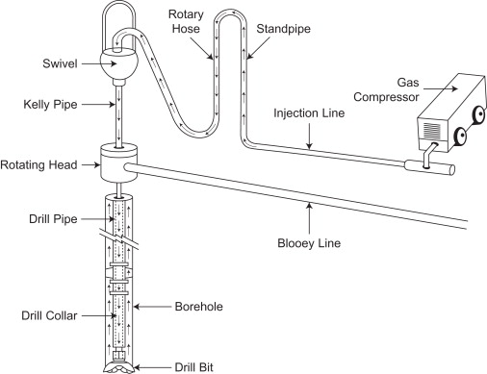
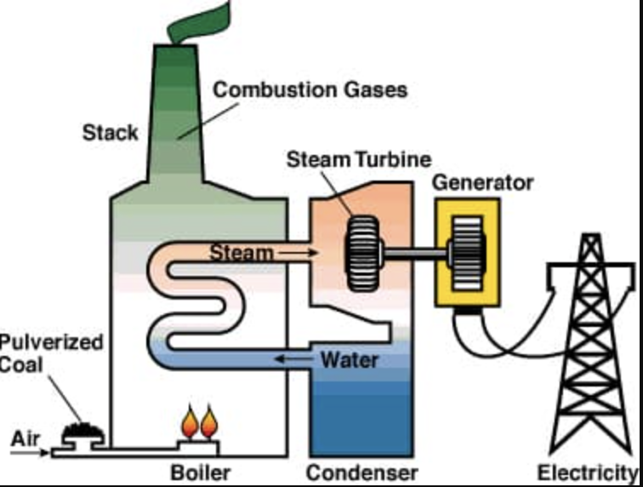
Exiting Flare Solutions
2- Gas reinjection:
Technique: This involves taking the associated gas and pumping it back into the underground oil reservoir.
Advantages: Injected gas can sometimes be used as part of EOR (Enhanced Oil Recovery) techniques to increase reservoir pressure and push more oil towards production wells.
1- On-site power generation:
Technique: Gas turbines combust the natural gas to produce hot gases that spin a turbine, generating electricity.
Advantages: Provides a reliable and continuous power source.
gas

Slide 5
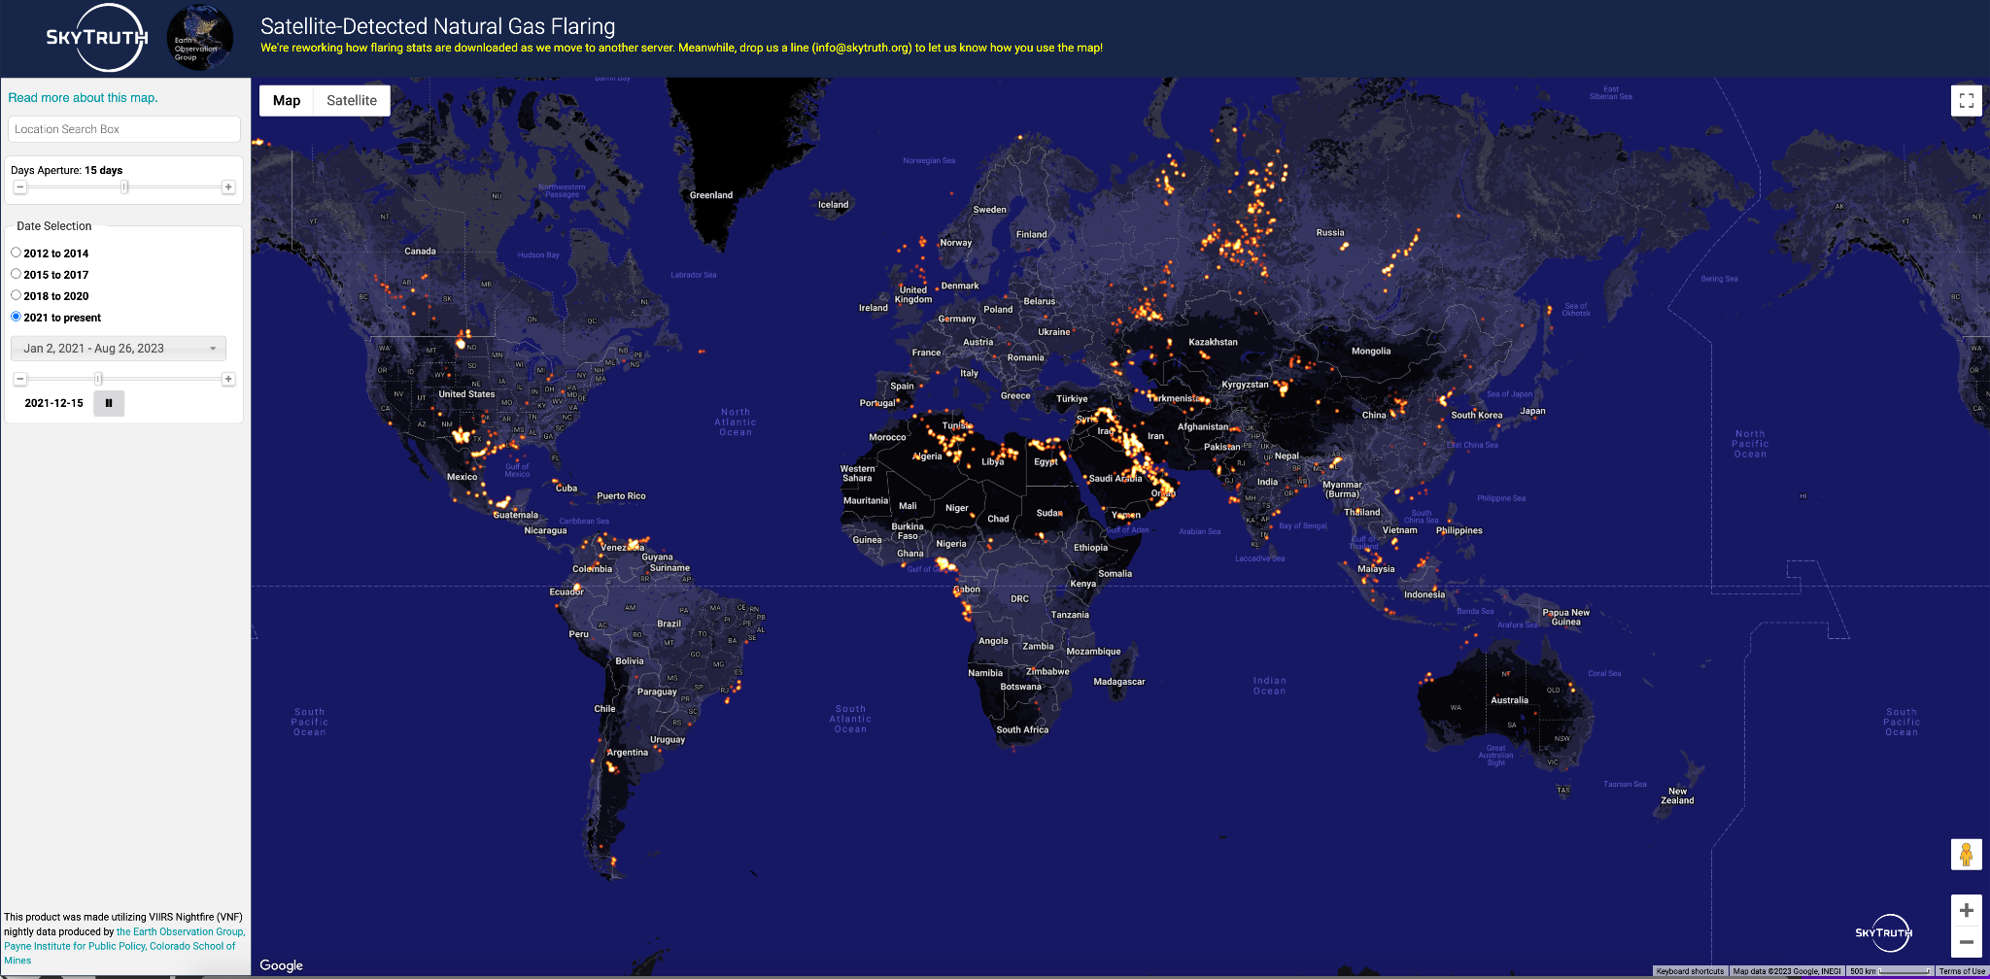

Slide 6
Challenges of Existing solutions
❌
❌
1- On-site power generation:
Since oil extraction is mostly done in remote locations, building new transmission lines costs 300,000$ to 3 million $ per mile.
The average cost of storing electricity in lithium -ion batteries is 132$ per kilowatt/hour. An 8 MW transformer is usually installed on smaller scale production sites.
2- Gas reinjection:
Requires significant investment in gas compression and injection equipment. Which can have severe profit margin cuts on smaller sized projects.
Not always suitable for all reservoir types or conditions.

Slide 7
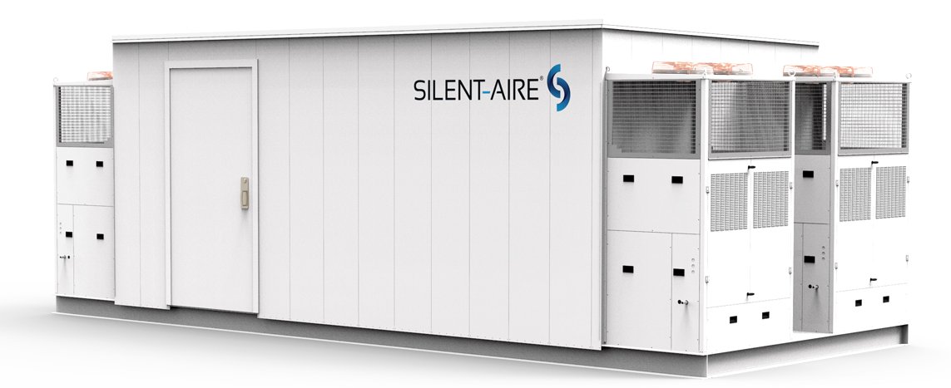
Our solution: Computing power on demand
Traditional on-site power generation + Modular data centers.

Slide 8
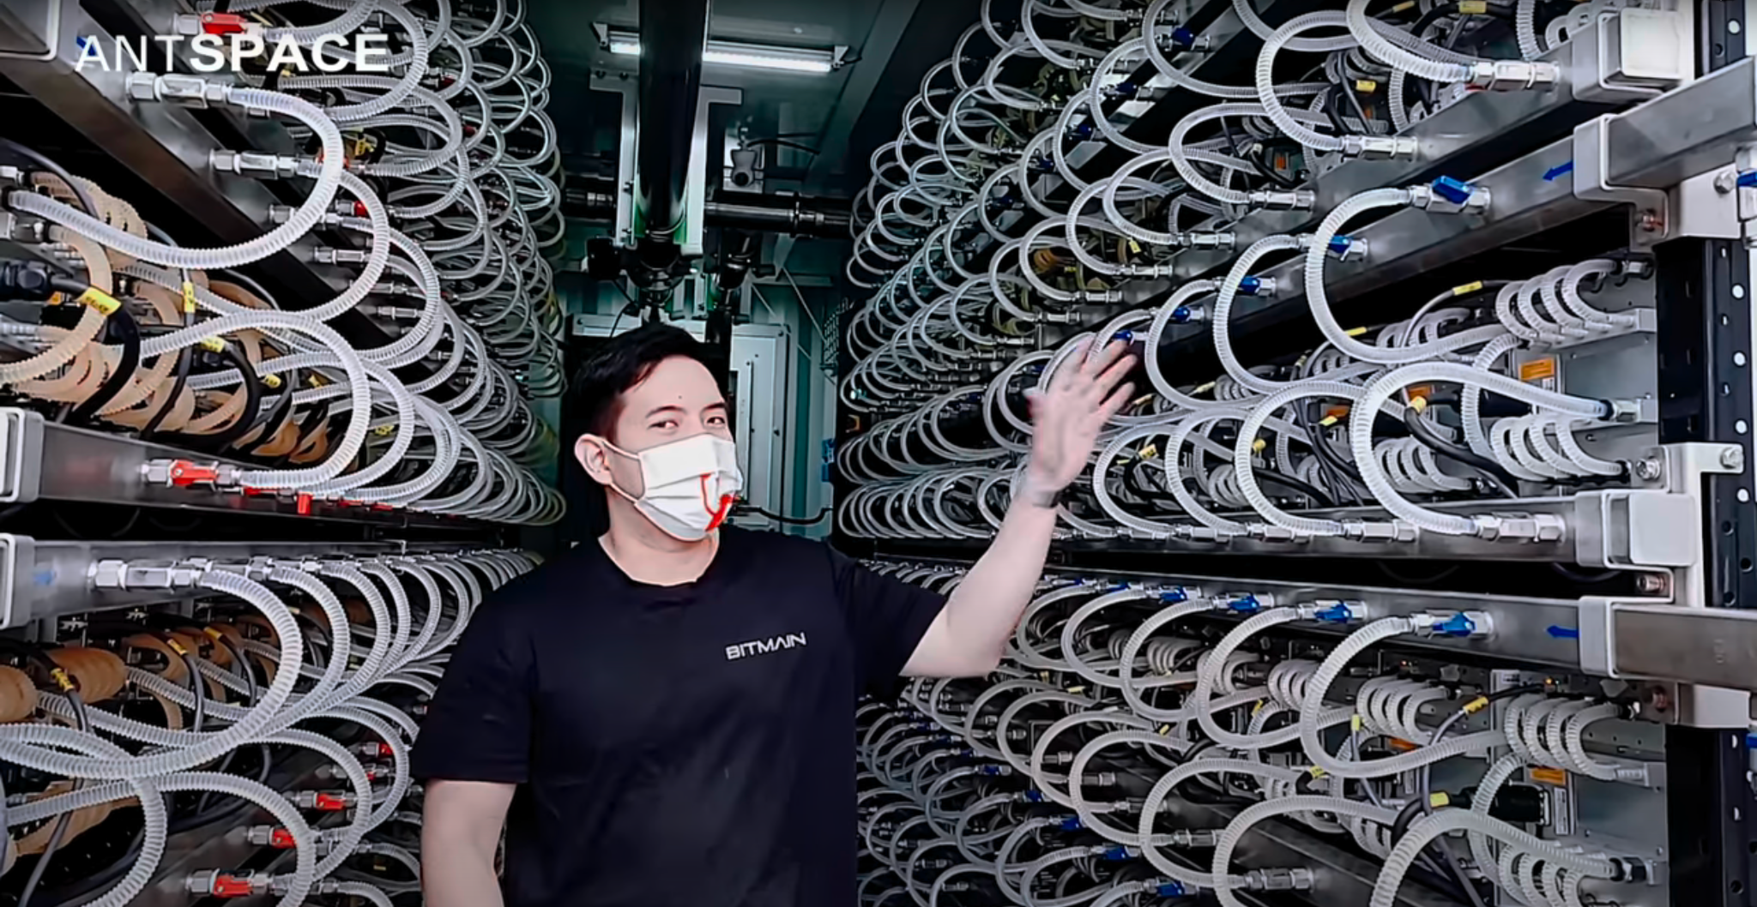

Slide 9
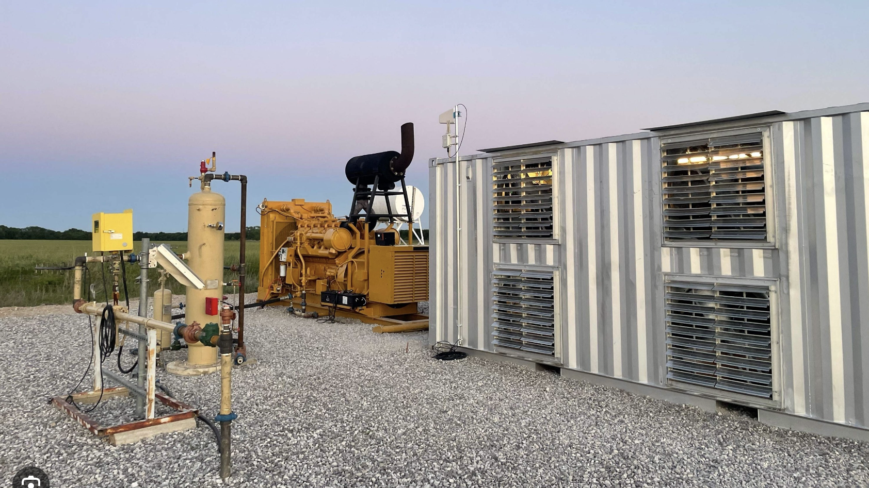

Slide 10
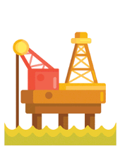

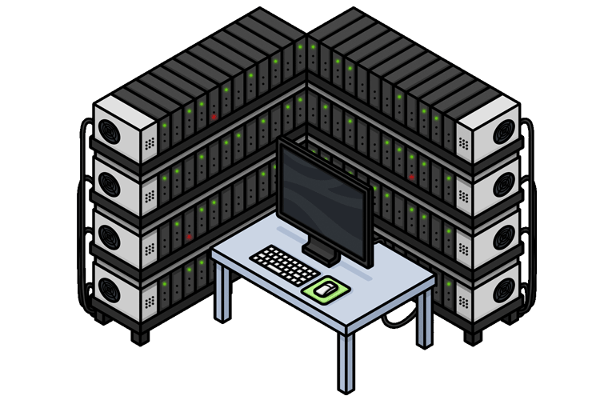


Solution
Power generation
power intensive computing
Waste gas from oil production
“our app”

Slide 11
Advantages of our Solution
1- Provide an additional stream of income for oil and gas companies.
2- Provide clean and affordable energy for power intensive computing projects.

Slide 12
Our Goal
Reducing the carbon footprint of the oil and gas industry, achieving so in an economically feasible manner.
Computing power on demand.
Providing a cost effective solution for power intensive computing, such as:
1- Blockchain
2- AI
3- Quantum computing

Slide 13

The UAE has succeeded in reducing flaring of natural gas from the oil and gas industry since the 1990s and its policy is shifting from minimal flaring to zero-tolerance.

Slide 14
Resources
1- https://www.eia.gov/state/print.php?sid=NY

